Slide 1
IDS Project – Adult Dataset
Chandratop Chakraborty
Abhishek Das
Rohan Biju

Slide 2
Dataset Overview
The adult dataset is census data from the US. The aim is to predict household income based on demographic factors.
Factors include age, relationship, occupation, race, sex, education, native country and a few more.
Contains 32561 rows of data.

Slide 3
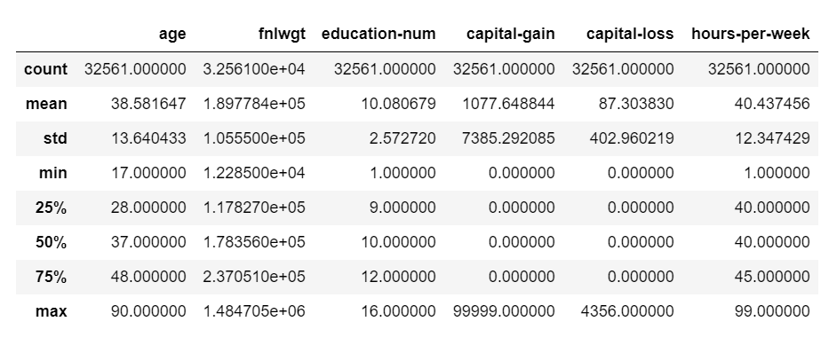
Dataset Overview

Slide 4
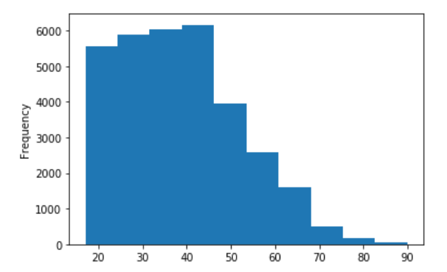
Age distribution

Slide 5
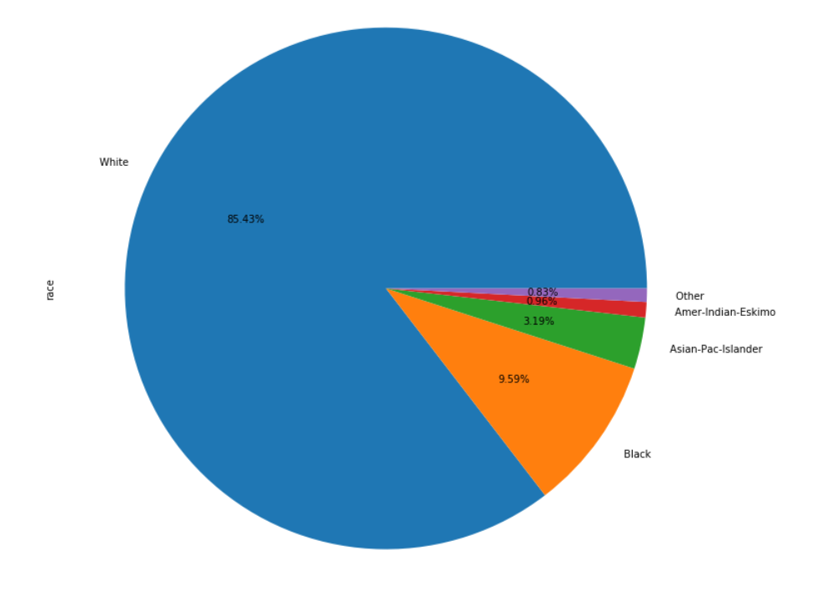
Ethnic group distribution

Slide 6
Aim
The aim of this dataset is to predict whether income is greater than or less than 50K USD
Now that we have a basic idea of the dataset, we have to find the columns with the maximum correlation

Slide 7
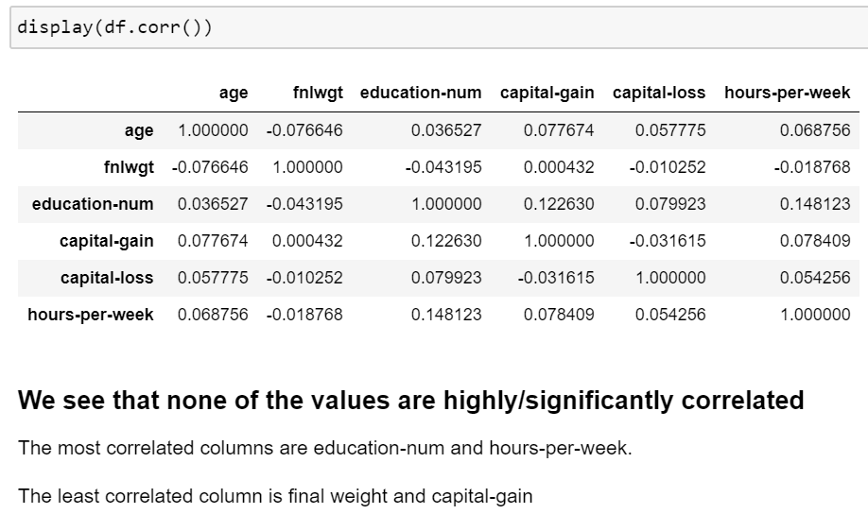
Correlation Matrix

